Slide 1
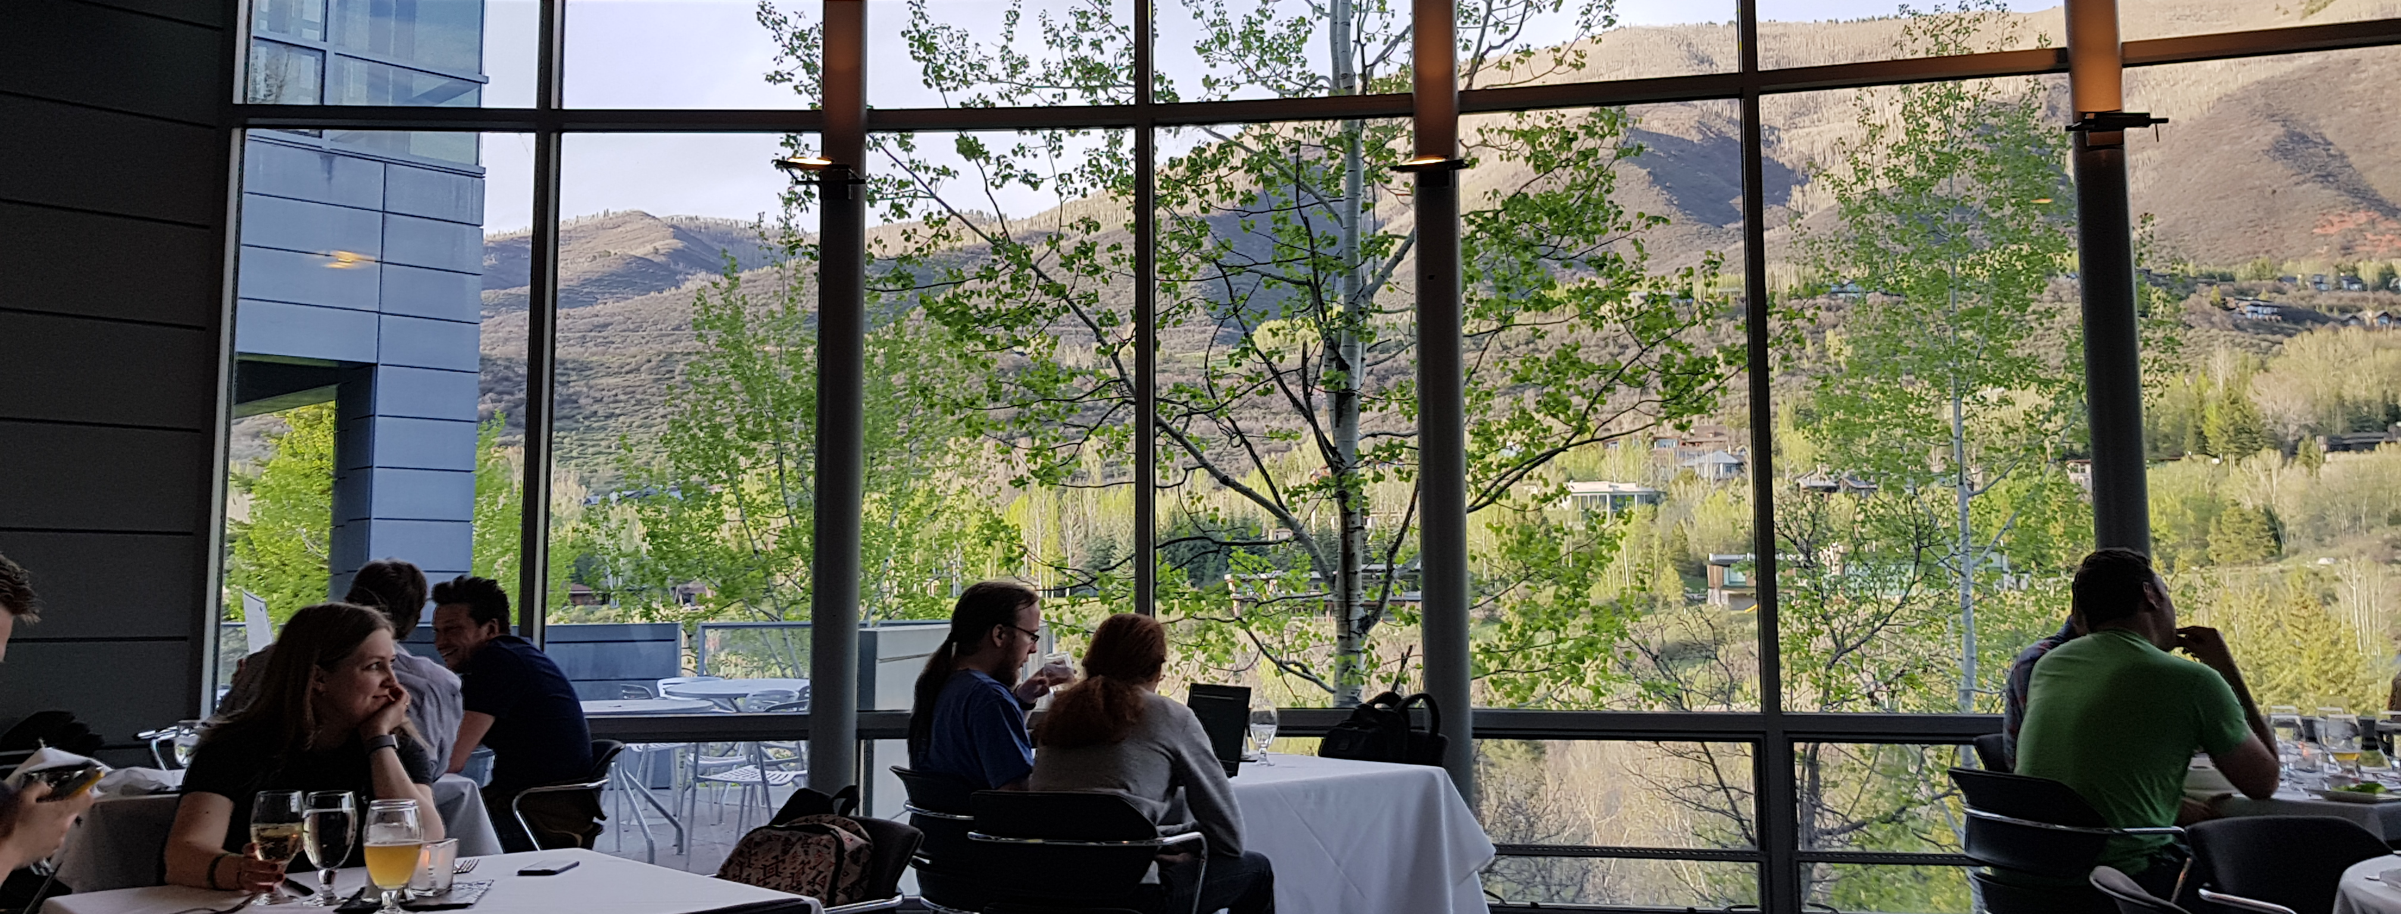
A view to a view
Peter Bindels / C++Now 2018
@dascandy42 / dascandy@slack

Slide 2
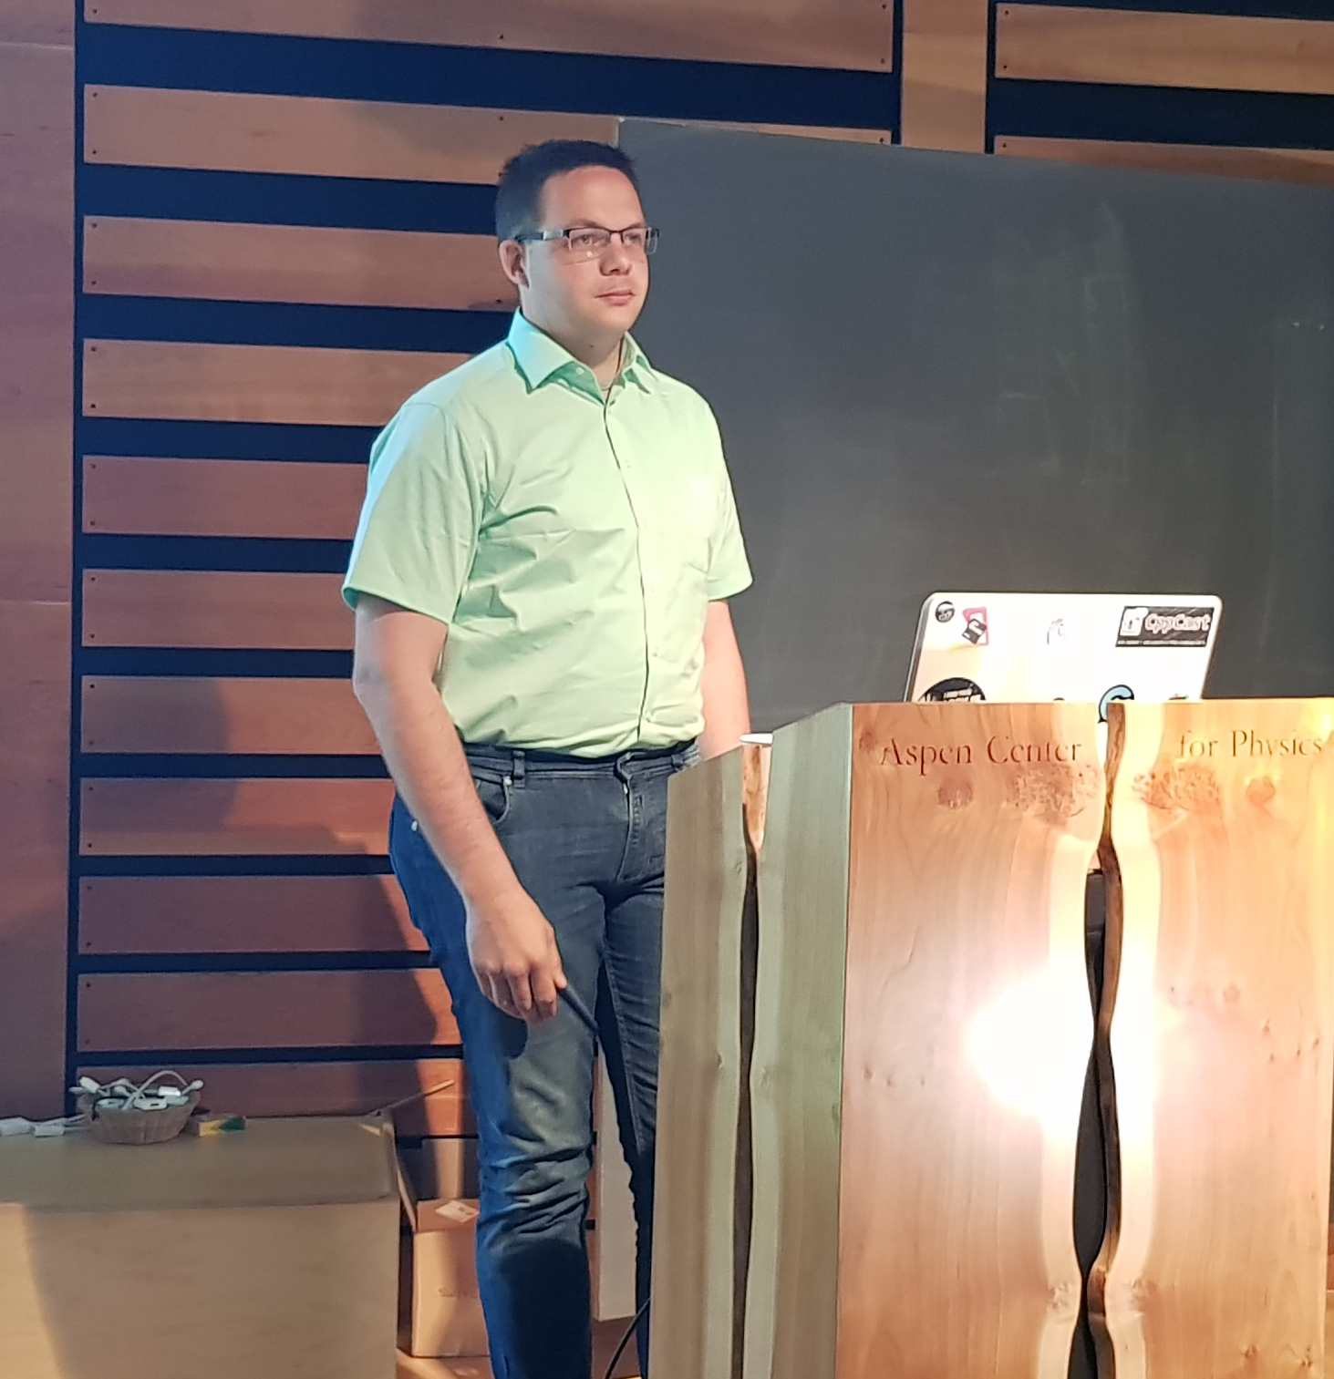

Peter Bindels
@dascandy42
dascandy@Cpplang slack
Author of HippoMocks (C++Now 2017)
Co-author of Cpp-Dependencies
(MeetingC++ 2016/2017)
https://github.com/dascandy/presentations
-~- Making the world of C++ simpler -~-

Slide 3
A view to a view
What is this presentation (not) ?
Terminology
Why views?
What kinds of views?
Thinking with views
When to use views?
Making a view

Slide 4
What is this presentation?
This talk is about the general concept of views and their benefits/downsides
Usable now
  and 20 years ago, if you’re a time traveller.
    Please try to avoid creating paradoxes…
Usable if you cannot use Ranges-v3
  Windows users

Slide 5
What is this presentation?
Practice focused
All examples are from actual use
  Not all actually in production, but intended for it

Slide 6
What is this presentation not?
It is not ranges-v3
  See Eric Niebler’s talk from CppCon 2015
I will try to keep as close as possible terminology-wise

Slide 7
A view to a view
What is this presentation (not) ?
Terminology
Why views?
What kinds of views?
Thinking with views
When to use views?
Making a view

Slide 8
Terminology
Input iterator
Read
Increment (without multiple passes)

Slide 9
Terminology
Forward iterator
Read
Increment (without multiple passes)
Increment (with multiple passes)

Slide 10
Terminology
Bidirectional iterator
Read
Increment (without multiple passes)
Increment (with multiple passes)
Decrement

Slide 11
Terminology
Random access iterator
Read
Increment (without multiple passes)
Increment (with multiple passes)
Decrement
Random access

Slide 12
Terminology
Contiguous iterator
Read
Increment (without multiple passes)
Increment (with multiple passes)
Decrement
Random access
Contiguous storage

Slide 13
Terminology
Note that the iterator categories map to range categories
  If your range returns an input iterator, it’s an input range
  If your range returns a forward iterator, it’s a forward range

Slide 14
Terminology
Range<T>
  The concept of multiple T’s, demarcated by begin/end
Ref<T>
  Non-owning type referring to a singular T
View<T>
  Non-owning type representing a lazy operation resulting in a range of T
  Underlying input may be anything

Slide 15
Terminology
Container<T>
  Owning type referring to a range of T
Action<T>
  Non-owning non-lazy operation resulting in a range of T
  Actively outputs, so needs target storage

Slide 16
A view to a view
What is this presentation (not) ?
Terminology
Why views?
What kinds of views?
Thinking with views
When to use views?
Making a view

Slide 17
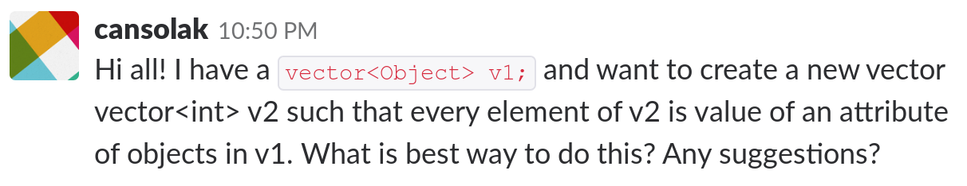
Why views?

Slide 18
Why views?
Unicode transcoding between encodings
  NxN problem
  Or Nx1 + 1xN problem

Slide 19
Why views?
Parsing a file
  All inputs already were allocated in memory
  Save a ton of copying
  You can refer back to the inputs for file line numbers and offsets directly

Slide 20
Why views?
Maximize the amount of work not done
Much more readable code
Lifetime and ownership

Slide 21
Maximize the amount of work not done
In games, if you don't see part of the world, it's not even loaded
If you can avoid sending something to the GPU, it's avoided where reasonably possible
If you do render it, and know that it'll be obscured, render the obscurer first so you will render less pixels total

Slide 22
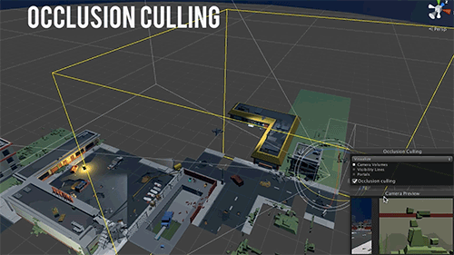
Maximize the amount of work not done

Slide 23
Maximize the amount of work not done
Total amount of work is reduced to the minimum.
  Sometimes by doing more work, to avoid doing heavy work elsewhere
  Sometimes by just not doing something at all
    Minecraft forest fires pause if you run away
    You don’t need food if you log out

Slide 24
Maximize the amount of work not done
If you're only using half of the output, you can get away with not transforming half of your input
You can stack multiple views together and only pay for the copy operation once

Slide 25
Maximize the amount of work not done
You can avoid heavy allocations for an intermediate result if your eventual result is (much) smaller
  Unicode transcoding
  You can use streaming outputs in some cases as well, for example in file transformations and network operations, without storing the whole file/network stream at any point

Slide 26
Maximize the amount of work not done
s2::basic_string_view<s2::encoding::cp437> string437
("Victor jagt zw\x94lf Boxk\x84mpfer quer \x81"
"ber den gro\xE1" "en Sylter Deich");
s2::basic_string_view<s2::encoding::utf8> ustring
("Victor jagt zwölf Boxkämpfer quer ü"
"ber den großen Sylter Deich");
REQUIRE(string437 == ustring);
s2::basic_string<s2::encoding::utf16>
u16string = ustring;

Slide 27
Maximize the amount of work not done
s2::basic_string_view<s2::encoding::cp437> string437
("Victor jagt zw\x94lf Boxk\x84mpfer quer \x81"
"ber den gro\xE1" "en Sylter Deich");
s2::basic_string_view<s2::encoding::utf8> ustring
("Victor jagt zwölf Boxkämpfer quer ü"
"ber den großen Sylter Deich");
REQUIRE(string437 == ustring); <-- No conversion needed
s2::basic_string<s2::encoding::utf16>
u16string = ustring; <-- No UTF32 code points stored

Slide 28
Much more readable code
Raise abstraction level
  Express what you do, rather than how
  Operations are what you want to do, not copy or move storage
Do complicated operations with a stack of views
  Much less data stored & copied
  In some contexts, avoid storing the whole data streaming contexts; you can avoid storing the whole stream at any point ever.

Slide 29
Lifetime and ownership
The major power of C++ is having controlled lifetime and ownership.
  Views subvert this by not owning their contents.
  Main risk is dangling references

Slide 30
Lifetime and ownership
std::string_view GetEntry(int index) {
auto it = list.find(index);
if (it != list.end()) {
return it->second;
}
return “No such entry”s;
}

Slide 31
Lifetime and ownership
std::string_view GetEntry(int index) {
auto it = list.find(index);
if (it != list.end()) {
return it->second;
}
return “No such entry”s;
}

Slide 32
Lifetime and ownership
Design principle: Design your API such that you making it hard to create dangling views
  You can’t prevent it

Slide 33
Views and iterator types
A view shouldn't raise the iterator type for its underlying range
  This would imply caching the full resulting sequence
  Then it’s not a view

Slide 34
Views and iterator types
Often, a view will have to lower the iterator type to a simpler one
  Only basic views are consecutive
  All others are at best bidirectional
  Maybe going back is prohibitively expensive or impossible

Slide 35
Views and iterator types
It can be beneficial to make the view cache a subsection
  A tar view, converting a byte stream into a range of files
    themselves again byte streams
  Each file itself can be fully cached, so a consecutive range
    Simpler to pass along
    Requires a full cache of that file

Slide 36
A view to a view
What is this presentation (not) ?
Terminology
Why views?
What kinds of views?
Thinking with views
When to use views?
Making a view

Slide 37
What kinds of views are there?
Basic views
Generators
Rope
Transform
Filter
Zip

Slide 38
Basic view types
Non-owning type referring to a range
std::string_view (C++17)
std::span (C++20)

Slide 39
Generators
Mostly similar to functional programming languages
Defines a (possibly infinite) range from limited inputs
In my opinion mostly funky to show, but not actually all that useful in production code.

Slide 40
Rope
Logical concatenation of multiple ranges
  Take multiple ranges satisfying the same concept
  Represents a single range with the same concept
  Logically contains the sequence of its inner ranges

Slide 41
Rope - Parsing code
#pragma once
int f();
#include “b.h”
int g();
#ifdef _WIN32
#include “windows.h”
#endif
class A {};
#pragma once
class B {
public:
virtual ~B() {}
};

Slide 42
Rope - Parsing code
#pragma once
int f();
#include “b.h”
int g();
#ifdef _WIN32
#include “windows.h”
#endif
class A {};
#pragma once
class B {
public:
virtual ~B() {}
};

Slide 43
Rope - Parsing code
#pragma once
int f();
#include “b.h”
int g();
#ifdef _WIN32
#include “windows.h”
#endif
class A {};
#pragma once
class B {
public:
virtual ~B() {}
};

Slide 44
Rope
This is not a new trick to do
  PCI Scatter-gather buffers

Slide 45
Rope
Can be expression template-like construct
  https://github.com/dascandy/s2
Can be runtime list/tree of segments
  https://github.com/tzlaine/text
Both implement the generic concept of having a second-order collection of things, being viewed as a first-order thing.

Slide 46
Transform
Original input after performing a smaller or larger transformation.
  Converting a span to an iteration of files viewed as a TAR or AR file
  Converting UTF8 data to a UTF32 view
  Converting a compressed input stream into an uncompressed stream

Slide 47
Transform
  Escaping or unescaping an input string
  Taking only the keys, or values, from a map
  to_string from a date, integer or such
  String split

Slide 48
Filter
Range containing a subset of its input
  skipping duplicate values
  taking only numbers that are prime
  taking only the talks you’ve selected
  taking only those entries that are currently enabled (by some ruleset)

Slide 49
Zip
Multiple ranges pairwise (tuplewise?) taken together to form a new range
Theoretically important concept
I haven’t actually needed it / used it

Slide 50
What's so hard about views to views?
Pre-C++17 is_same(decltype(begin(x)), decltype(end(x))) in a range-based for loop
This means that an N-th order view’s iterators will be 2x the size of a N-1th order view’s iterator
A 5-high stack of views-to-views-to-views has at least 97% memory wasted to this

Slide 51
What's so hard about views to views?
C++17 allows end(x) in a range-based for loop to be a different type
This makes views-to-views much smaller
  Make the end type a one-byte sentinel
There is a pre-C++17 “workaround” with caveats

Slide 52
What's so hard about views to views?
Who actually owns what?
Can you store a view as itself?
  Do you want to?

Slide 53
A view to a view
What is this presentation (not) ?
Terminology
Why views?
What kinds of views?
Thinking with views
When to use views?
Making a view

Slide 54
Thinking with views
For any given operation
  Can you represent the desired output as an iteratable conversion of the input?
  Does the operation require amortized O(1) work to increment the view iterator?
Then a view is a great idea

Slide 55
Thinking with views
Creating a view
  Create iterator state that maps your output position to the input domain
  Allow constructing a view from a valid input range
  Given an output position, extract the value for it from the iterator state

Slide 56
Thinking with views
Many of these views are conceptually other things
This foreshadows the need for concepts, as this is a "String-like object" that no string / text designer could anticipate
You can implement concepts (pretty much), see ranges-v3
Not implementing it loses type safety

Slide 57
A view to a view
What is this presentation (not) ?
Terminology
Why views?
What kinds of views?
Thinking with views
When to use views?
Making a view

Slide 58
When to use views
Often!
  Culling in graphics
  Parsing inputs / files
  Destructuring
  Lazy conversions from one type or representation into another
Makes your code much easier to read

Slide 59
When to use views
But only if you know lifetimes will be good
  All data must be owned by something

Slide 60
A view to a view
What is this presentation (not) ?
Terminology
Why views?
What kinds of views?
Thinking with views
When to use views?
Making a view

Slide 61
How to make a simple view
This is not a ranges-v3 view. It’s “just a class” that happens to do something really similar.
Major benefit is simplicity in making new views
Does not interact with ranges-v3 style views directly
Think of it as a “gateway” to using views

Slide 62
How to make a simple view
For new people, these are the “nothing up my sleeve” views
  There’s no library code to hide behind
  There’s no magic happening
  They’re short and simple enough that we can do three

Slide 63
How to make a simple view
Keys
Int-as-a-string_view
Basic lambda filter

Slide 64
How to make a simple view
template <typename Container>
struct keys_view {
keys_view(Container& c)
: it_(std::begin(c))
, end_(std::end(c))
{}
decltype(std::begin(::std::declval<Container&>())) it_;
decltype(std::end(::std::declval<Container&>())) end_;
...

Slide 65
How to make a simple view
template <typename Container>
struct keys_view {
...
struct sentinel {};
keys_view& begin() {
return *this;
}
sentinel end() {
return sentinel();
}
...

Slide 66
How to make a simple view
template <typename Container>
struct keys_view {
...
keys_view<Container>& operator++() {
++it_;
return *this;
}
auto &operator*() {
return it_->first;
}
bool operator!=(const sentinel&) {
return it_ != end_;
}
bool operator==(const sentinel&) {
return it_ == end_;
}
};

Slide 67
How to make a simple view
std::map<std::string, int> numbers;
for (auto& key : keys(numbers)) {
std::cout << key << “\n”;
}

Slide 68
How to make a simple view
std::map<std::string, int> numbers;
for (auto& key : keys(numbers)) {
std::cout << key << “\n”;
}
std::string hi = “Hello C++Now 2018 attendees!”;
for (const auto& str : split(hi, ‘ ‘)) {
std::cout << str << “\n”;
}

Slide 69
How to make a simple view
struct int_view {
int_view(int n)
: n(n)
, index(0)
{
if (n >= 0) ++(*this); // skip minus sign space
}
int n, index;
...

Slide 70
How to make a simple view
struct int_view {
...
struct sentinel {};
int_view& begin() {
return *this;
}
sentinel end() {
return sentinel();
}
bool operator!=(const sentinel&) {
return index != 11;
}
bool operator==(const sentinel&) {
return index == 11;
}
...

Slide 71
How to make a simple view
struct int_view {
...
int_view& operator++() {
++index;
if (index == 1) {
while (**this == ‘0’ && index < 10) index++;
}
return *this;
}
auto &operator*() {
if (index == 0) return (n < 0) ? ‘-’ : ‘+’;
int tmp = n;
for (int i = index; i < 10; i++) tmp /= 10;
return (tmp % 10) + ‘0’;
}
};

Slide 72
How to make a simple view
int_view i(42195);
std::string s(i.begin(), i.end());
// s is now “42195”

Slide 73
How to make a simple view
template <typename Container, typename Pred>
struct filter_view {
struct sentinel {};
filter_view& begin() {
return *this;
}
sentinel end() {
return sentinel();
}
decltype(std::begin(::std::declval<Container&>())) it_;
decltype(std::end(::std::declval<Container&>())) end_;
auto &operator*() {
return *it_;
}
bool operator!=(const sentinel&) {
return it_ != end_;
}
bool operator==(const sentinel&) {
return it_ == end_;
}
...

Slide 74
How to make a simple view
template <typename Container, typename Pred>
struct filter_view {
...
filter_view<Container, Pred>& operator++() {
do {
++it_;
} while (it_ != end_ && !pred_(*it_));
return *this;
}
filter_view(Container& c, Pred&& p)
: it_(std::begin(c))
, end_(std::end(c))
, pred_(std::move(p))
{
while (it_ != end_ && !pred_(*it_)) ++it_;
}
};

Slide 75
How to make a simple view
for (auto& key : filter(keys(myMap),
[](auto& k) { return k.hash < 42; }
)) {
std::cout << key << “\n”;
}

Slide 76
How to make a simple view
You can cheat
  Make your sentinel the same object as your iterator
  Make your comparison pretend to always compare to the end iterator
  Works in C++11 range-for, no size overhead

Slide 77
How to make a simple view
You can cheat
  Make your iterator the same as your range
  Avoids a copy
  If somebody copies the iterator or the range, it will still work
  Easy to undo – remove the & on the return type of begin
    Alternatively, split off the iterator logic

Slide 78
How to make a simple view
This is risky
  If anybody tries to treat it as a forward iterator it’ll fail horribly and be very hard to debug

Slide 79
Questions?

Slide 80
References
https://github.com/dascandy/view
  General view types that are easy to understand
https://github.com/dascandy/s2
  Std2 playground, currently with a string that uses views & ropes
https://github.com/dascandy/compiler
  C++ lexer that lexes as a pure view. All tokens are string_views into the input

Slide 81
References
https://github.com/tzlaine/text
  Zach Laine’s full-fledged Unicode text library. Uses views where possible.
https://github.com/ericniebler/range-v3
  Eric Niebler’s Range-v3 library. It’s the mathematically-complete counterpart to this bare-bones view style.

Slide 82

References
https://cpplang.slack.com/
  Join at https://cpplang.now.sh/
  #learn
  #cppnow
  #plug_worthy
  #speakerscorner

